Slide 1

Predicting Credit risk using south German credit data
BY- ADHIRAJ SINGH SHEKHAWAT

Slide 2
OBJECTIVE:
BENEFITS:
The purpose of this project is to predict credit risk of bank Using South German credit data and machine learning techniques.
1This will give an idea of which applicant are prone to credit default
it helps to evaluate the creditworthiness of borrowers and mitigate the risk of default.
This will help in reduce NPA’s
Help a bank to automate the work for predicting credit risk associated with a loan applicant

Slide 3
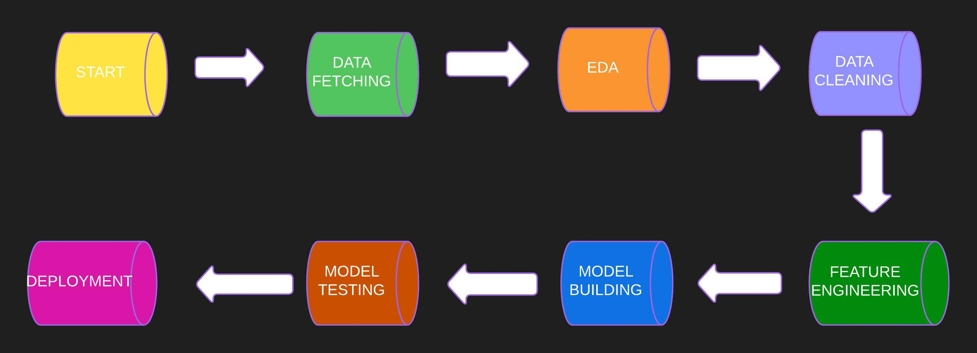
ARCHITECHTURE

Slide 4
DATA COLLECTION AND VALIDATION
This dataset is collected from UCI UCI Machine Learning Repository website.
Data type : Checked the data types for all the columns present in the data.
Data cleaning : Checked presence of null values and duplicated values.

Slide 5
MODEL TRAINING
DATA PREPROSESSING:
EDA is performed to clean the data and to get insights from the dataset to understand it clearly.
Checked from null, duplicate values , if any found, they are handled.
Handled outliers in the data.
Visualization is done to get better insights and understanding of the data.
Removed skewness left or right from the data.
Oversampled the minority class which will remove bias of the model towards majority class.
Training model:
After EDA, the data is trained on multiple algorithms.
Various algorithms are used to select the best one.

Slide 6
MODEL SELECTION
After the data pre-processing part, the data is trained on multiple algorithms like:
Decision Tree
Random Forest
XG boost
Gradient Boosting
Ada Boosting
After training data on above algorithms, we calculated the accuracy for each model and selected the model which gave highest accuracy.
In our case, Gradient boosting model gave the highest accuracy, so has been selected as a final model.

Slide 7
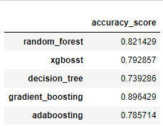
PREDICTIONS

Slide 8
Q and A:
What is source of data?
Data is collected from UCI machine learning repository. The data is present in asc format.
2) What was the type of data?
The data is combination of numerical values.
3)What is the complete flow you followed for project?
- Refer to the slide 3 for better understanding
4) What techniques were you using for data pre-processing?
EDA is performed to clean the data and to get insights from the dataset to understand it clearly.
Checked from null, duplicate values , if any found, they are handled.
Handled outliers in the data.
Visualization is done to get better insights and understanding of the data.
Removed skewness left or right from the data.
Oversampled the minority class which will remove bias of the model towards majority class

Slide 9
5) How training was done or what models were used?
Before training the model, data was divided into training and testing set.
5 algorithms are used to train the model.
These 5 algorithms are as follows:
Decision Tree
Random Forest
Xgboost
Ada Boosting
Gradient Boosting
Checked the accuracy, Gradient boosting algorithm is selected.
6) How prediction was done?
-On the basis of trained model, the prediction was done.
7) What are the different stages of deployment?
Created API interface using Flask
Deploying on cloud AWS,Azure,GCP,Heroku

